Slide 1
Sign Language Translator Using CNN and CVZONE
Name: Yadhu Kishan T R
Training Center: ICFOSS

Slide 2
Project Overview
Implemented CNN to classify sign language gestures
The Dataset used is American Sign Language MNIST from kaggle
Tools like Google Colab,PyTorch,OpenCV and CVZone was used to create this project
I got 100% accuracy on test dataset but low real-time accuracy

Slide 3


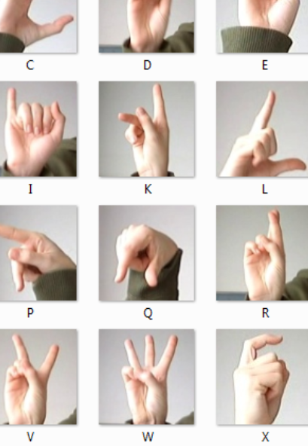

About The Dataset
Sign Language MNIST (CSV format)
28*28 grayscale images, values 0-255
27,455 training images and 7,127 test images
Letters A-Z (excluding J and Z due to motion)

Slide 4
Implementation Setup
Training is done in Google Colab with PyTorch CNN
Real-time testing in OpenCV + CVZone
Based on a tutorial (Murtaza's Workshop):
  Tutorial: Used Teachable Machine and .h5 model file format
  My Project: Custom CNN in PyTorch, .pth model file format

Slide 5
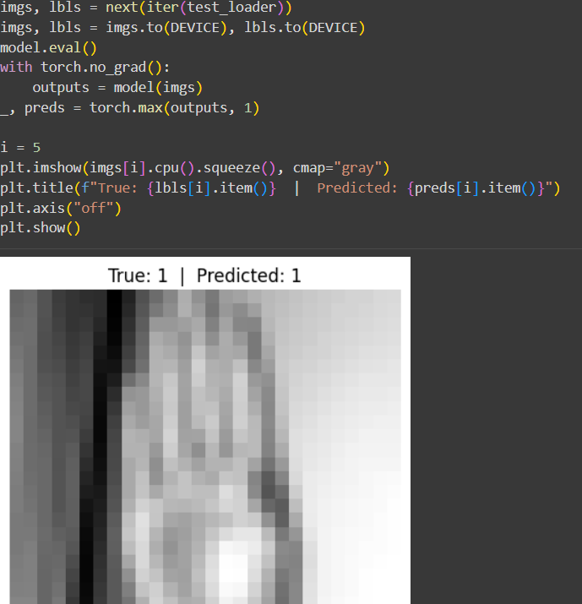
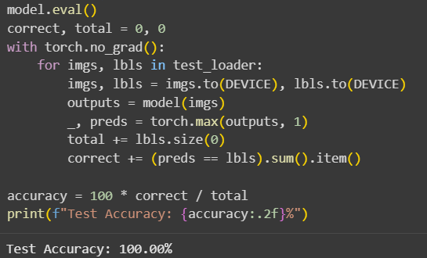
Methodology
Data Preperation
  Extracted Labels(A,B,C) for testing
  Converted CSV -> 28*28 grayscale tensors
  Normalized and batched with DataLoader
CNN Model
  Custom architecture, trained 10 epochs
  Achieved 100% accuracy on test data

Slide 6
3. Live Gesture Detection
Load Model(Sign_Language_cnn.pth)
Capture webcam input (OpenCV)
Detect hand(cvzone.HandTrackinModule)
The hand is cropped to 28*28 and then to grayscale
Predicted gesture in Real- Time

Slide 7
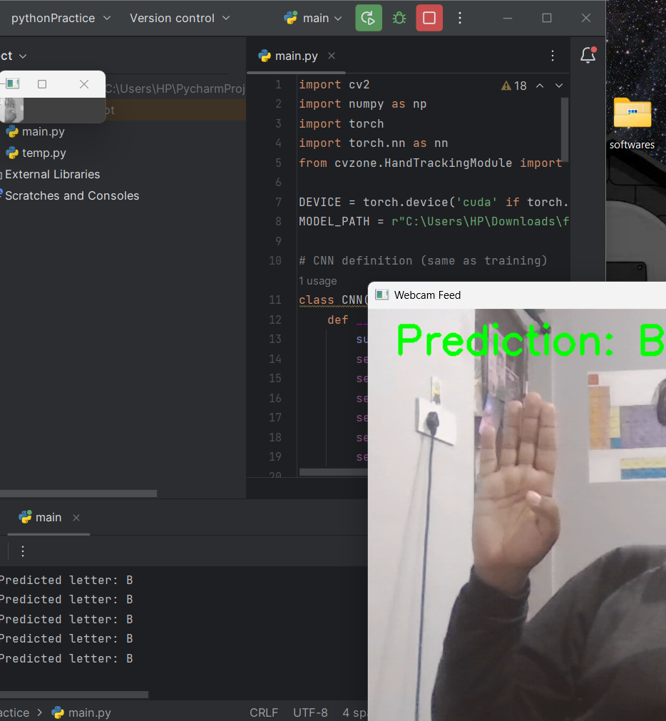
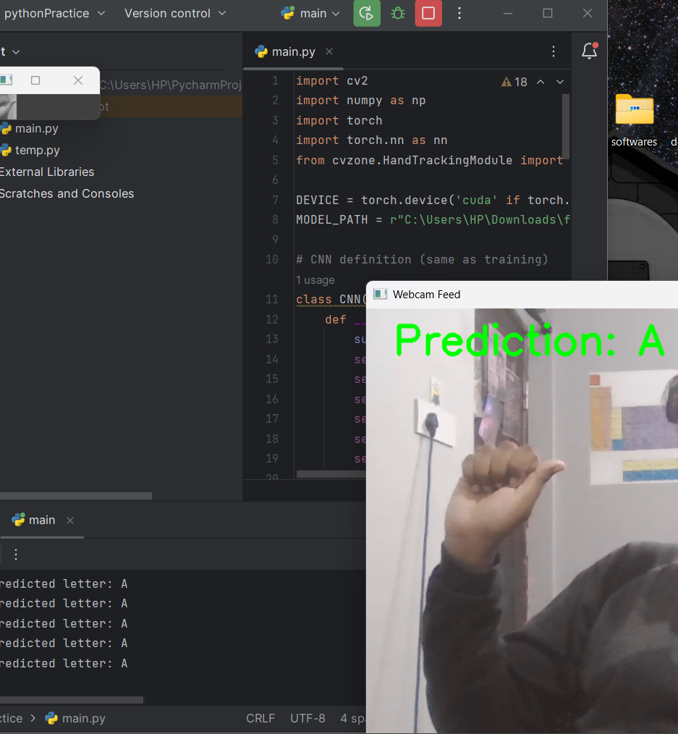

Slide 8
Results
Test Dataset: 100% accuracy
Live Detection: Detected A,B,C but lower accuracy
Limitation:
  Over fitting due to low amount of dataset
  Real-world lighting,
  hand alignment effect
  performance and motion gestures cannot be recognized by this method

Slide 9
Conclusion
CNN successfully recognized hand gestures
.pth model resuable for real-time prediciton
Can be exteded to more letter and gestures
In Future it can be improved accuracy with large datasets

Slide 10
Acknowledgement
Training Center: ICFOSS
Online Course: Deep Learning
Dataset Source: Kaggle MNIST sign Language
Tutorial Reference: Murtaza's Workshop
Additional support: online resources and AI assistance

